Slide 1
Gramener Case Study SUBMISSION
Group Name:
Anusha Kulkarni
Ramya sri sai Ch
Rudra sen
Husn Ara

Slide 2
Data Exploration
Data set contains total 111 columns but all these columns are not useful for analysis, so we need to do date refinement .
After checking the null values we have removed the columns which are have >70% of null .
We found what are the variable used for analysis
Categorical variables
Quantitative variables
Business Objective:
Is to identify the risky applicants, to reduce largest source of financial loss(called credit loss) to company.
Based on the business objective we should focus on Categorical variables and Quantitative variables

Slide 3
Variables Identified For Analysis
Loan Status
Term
Interest rate
Grade
Sub Grade
Employee Length
Home Ownership
Verification
Annual Income
Issue Date(only year we used)
Purpose
dti

Slide 4
Data Cleaning and Manipulation
Possible Data Inconsistencies :
Checking for duplicates on member id.
Cleaning the n/a values in the columns we identified that null values >70%
Dropping unnecessary columns which are not used for analysis.
Other Issues :
Converting the data type of int_rate column to float as it contains % in the cells
In employee length we should extract only the integers
Converting the data type of issue date to date time and extract only year

Slide 5
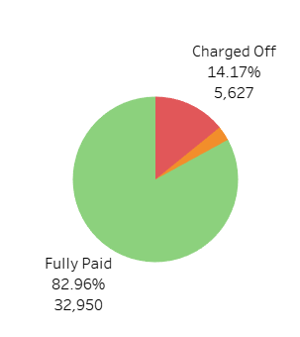
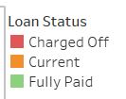
Analysis
From the data, observed that
The defaulters are of 14.17% for Fully Paid , Current and Charged Off values.
Whereas 15% for Fully Paid and Charged Off.
Using EDA have to identify ,the driving factors (or driver variables) behind loan default, i.e. the variables which
are strong indicators of default.

Slide 6
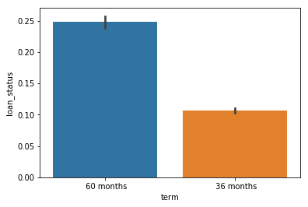
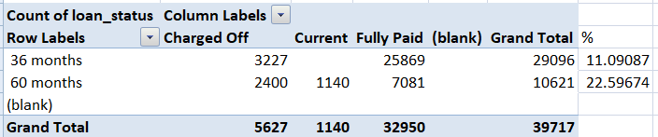
Term Analysis
Observations from term Analysis
Defaulters ratio is more in 60 months term than 36 months

Slide 7
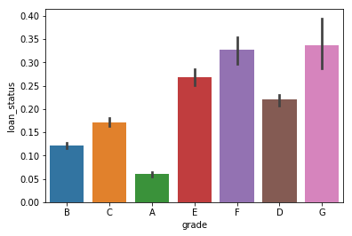
Grade Analysis
Observations from Grade Analysis
The percentage of defaulters are more in Grade G
Verification Analysis
Also observed that the percentage of bad loans not verified customers are also fall under grade G

Slide 8
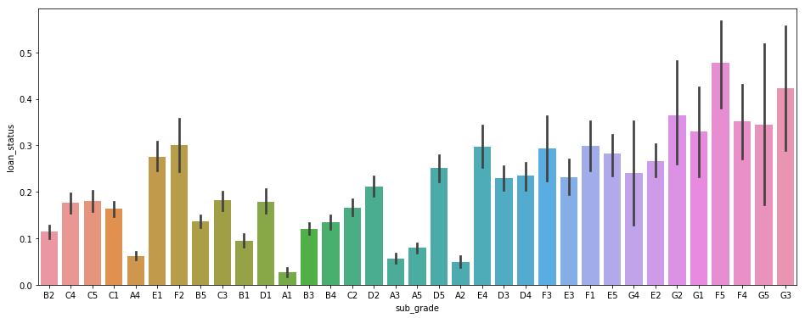
Sub Grade Analysis
Further analysis in Grade-G, identified that sub-grade F5 is more is count.
Conclusion :
Sub Grade F5 under Grade G having more defaulters and indentified as not verified customers falling under this category.

Slide 9
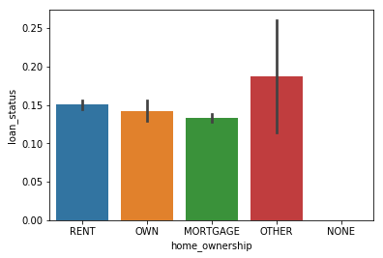
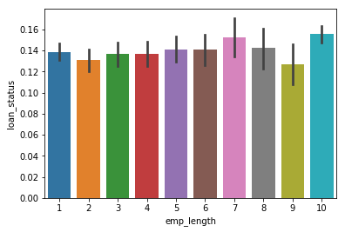
Home Ownership Analysis
Observed that the more defaulters are falling under others ownership
Conclusion:
The company has to take more precautions while sanctioning loans to others
Employee Length Analysis
Observed that the more defaulters are having greater than 9 years experience.
Conclusion:
The company has to take care in providing loans to more than 9 years experience.

Slide 10
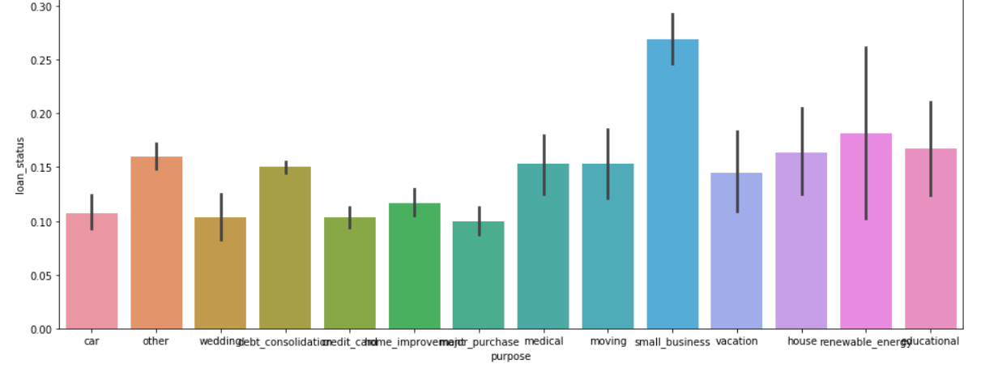
Purpose Analysis
Observed that the more defaulters are falling under customers having purpose with small business
Conclusion:
Company can avoid loans to small business, purpose to reduce the amount of credit loss.

Slide 11
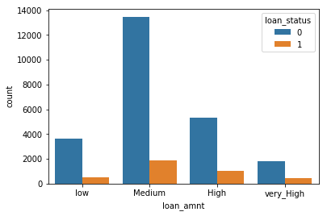
Binning loan amount into categories
LOAN AMOUNT | CATEGORIES
0-5000 | LOW
5000-15000 | MEDIUM
15000-25000 | HIGH
25000-40000 | VERY HIGH
The company should be careful while giving high loans

Slide 12
Conclusion:
Here are the suggestions company can utilise this knowledge for its portfolio and risk assessment.
Company should take care in providing loans to customers with following behaviours :
who are going for 60 month term.
Falling under Grade G and A as sample ratio is varying
Having Others house ownership.
With more than 9 years experience.
Having purpose of small business and debt consolidation.

